Slide 1

CAR ACCIDENT SEVERITY ANALYSIS
GROUP 2
SHALINI MOPURI
KIRAN GORIJALA
ASHRITHA KORUKANTI

Slide 2

TABLE OF CONTENTS
INTRODUCTION
DATA SOURCES AND COLLECTION
PROJECT OBJECTIVES AND GOALS
TOOLS AND TECHNOLOGIES
DATA EXPLORATION
RECOMMENDATIONS
FUTURE OPPORTUNITIES
CHALLENGES
CONCLUSION
REFERENCES

Slide 3
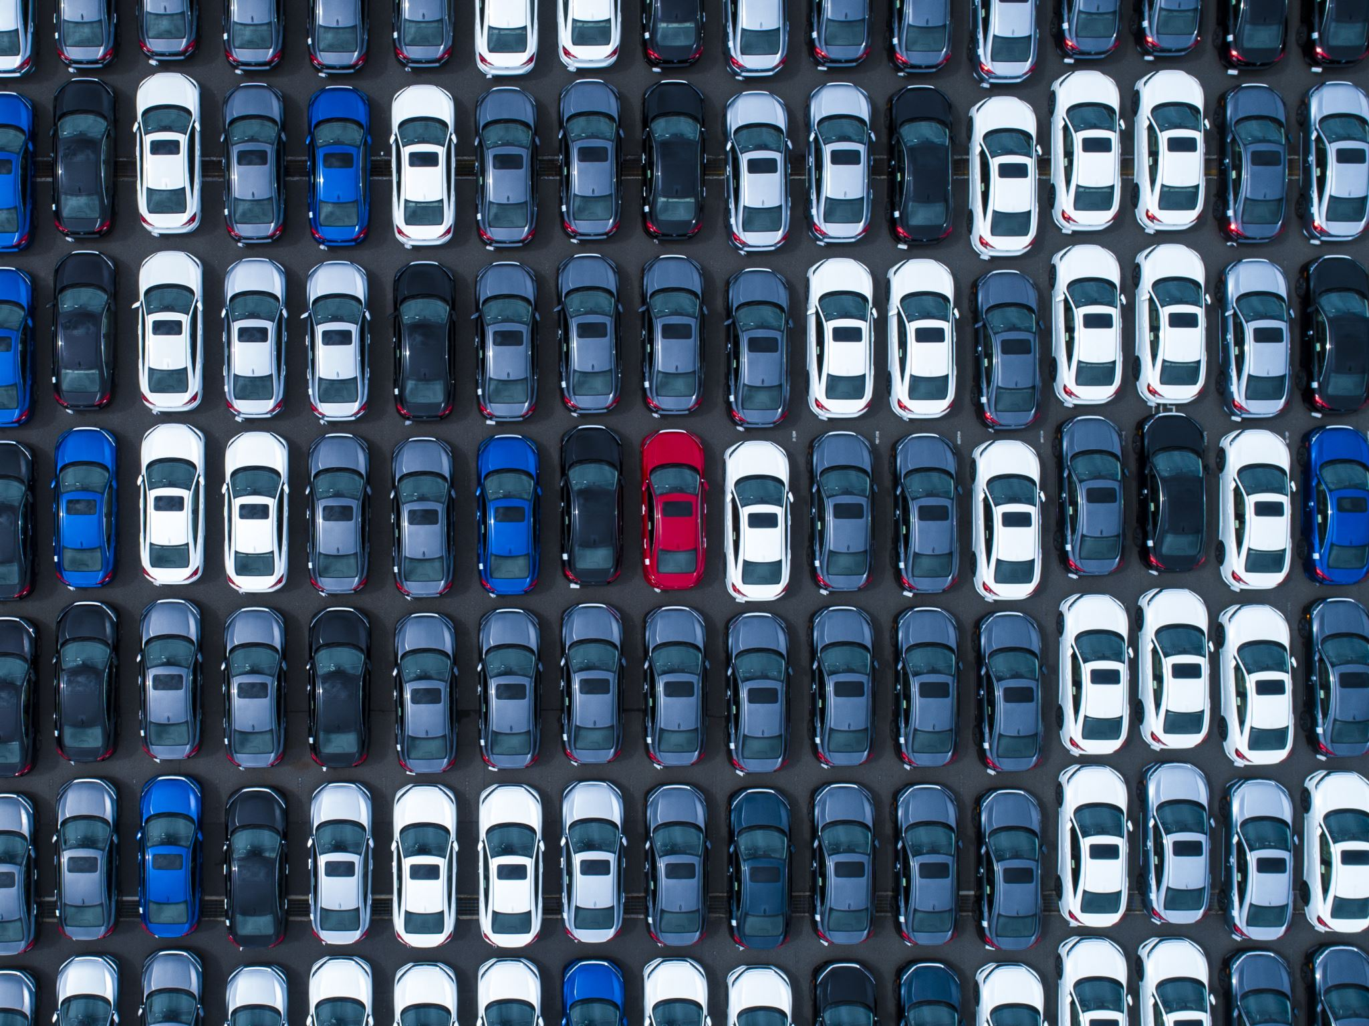
INTRODUCTION
The project aims to analyze car accident severity and understand the factors that contribute to different levels of accidents. By examining various data sources and applying statistical analysis, we can gain insights into the causes and consequences of car accidents, which can inform strategies for prevention and intervention.

Slide 4
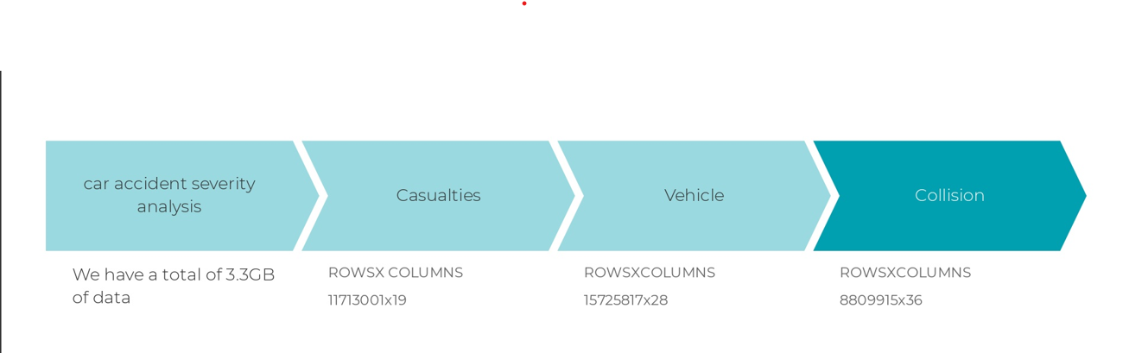
DATA SOURCES AND COLLECTION
UK police forces collect data on every vehicle collision in the uk and is published at https://data.gov.uk/dataset/road-accidents-safety-data.

Slide 5
PROJECT OBJECTIVES
Collect extensive accident data that takes into account the location, weather, vehicle information, and the severity of the event.
Discover patterns, trends, and relationships between variables by exploring the dataset.
Create prediction algorithms to calculate the severity of car accidents based on relevant features.
Identify the factors that significantly affect how severe an accident is.

Slide 6

PROJECT GOALS
To create models that can accurately predict the severity of car accidents.
Provide recommendations and strategies for enhancing road safety from the data driven insights.
The project aims to contribute in reducing the severity of accidents and improving over all safety

Slide 7
STACK DIAGRAM
DATA SOURCE
(UK GOVT DATA)
DATA COLLECTION LAYER AND DATA INGESTION LAYER
DATA VISUALIZATION
(Seaborn, Matplotlib, sweetvix, plotly)
DATA QUERY LAYER
(PySpark, SQL)
ANALYTICS ENGINE
Machine Learning
DATA PROCESSING
Batch Processing
Real-time Processing
Hybrid processing
DATA STORAGE
HDFS

Slide 8

TOOLS AND TECHNOLOGIES
Data Collection: We collected the data from UK Government data website.
Data Storage: We used Hadoop Distributed File System (HDFS) for storing the data. HDFS provided scalable and fault-tolerant storage solution.
Data Processing: PySpark and SQL was our choice for data processing. PySpark providing a a distributed computing framework for big data processing and SQL is a powerful language for querying and managing structured data.
Machine Learning: We used Machine Learning libraries and models using advanced algorithms to enhance safety and risk assessment in the transportation domain.
Data Visualization: To visualize our analysis results, we used matplotlib, Seaborn, Sweetvix and plotly.

Slide 9
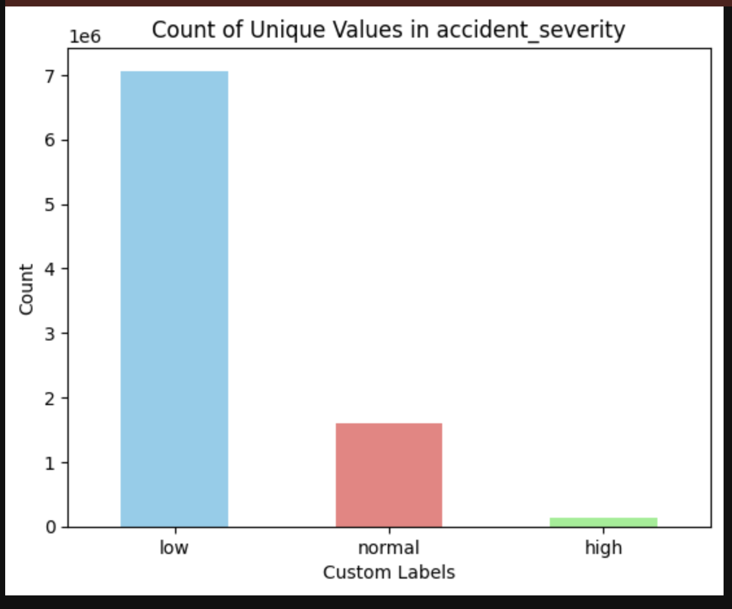
Data Exploration: Uncovering Trends in Accident Severity
The bar graph is created to display the distribution of different accident severity levels within the dataset.
we have 3 levels to predict the severity of accident that is LOW , NORMAL , HIGH.
This visualization provides a quick and clear overview of the distribution of accident severity levels in the dataset, allowing stakeholders to understand the prevalence of different types of accidents.

Slide 10
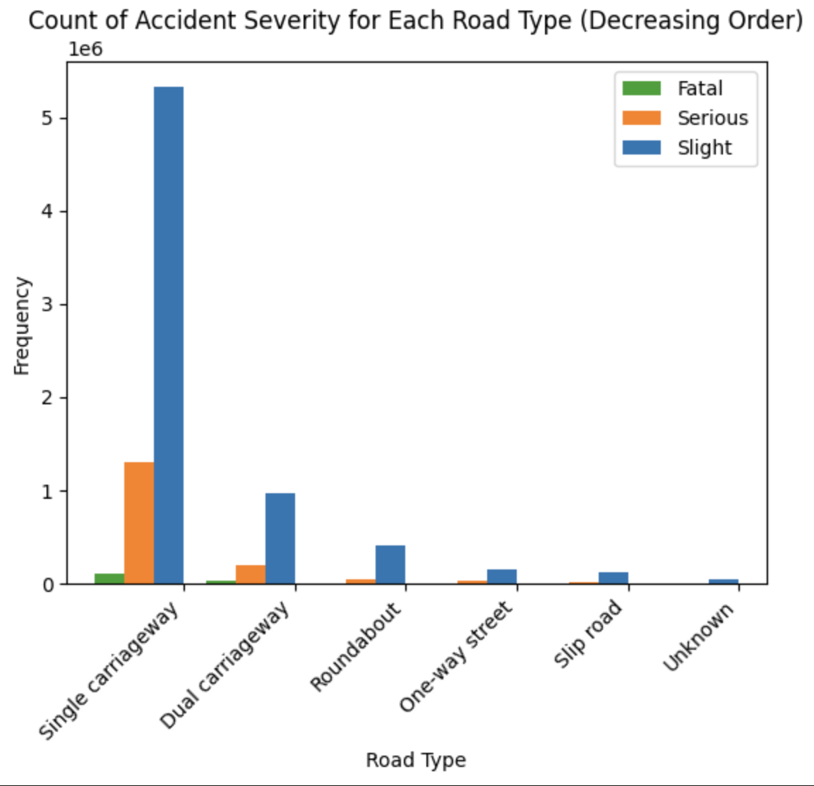
The purpose of using a stacked bar graph against the count of accident severity for each road type is to visually compare and contrast the distribution of accident severity levels across different road types.
The x-axis shoes the different types of roads and the Y-axis shows the count.
The stacked bar for each road type provides a comprehensive view of how different severity levels contribute to the overall accident count on that specific type of road.

Slide 11
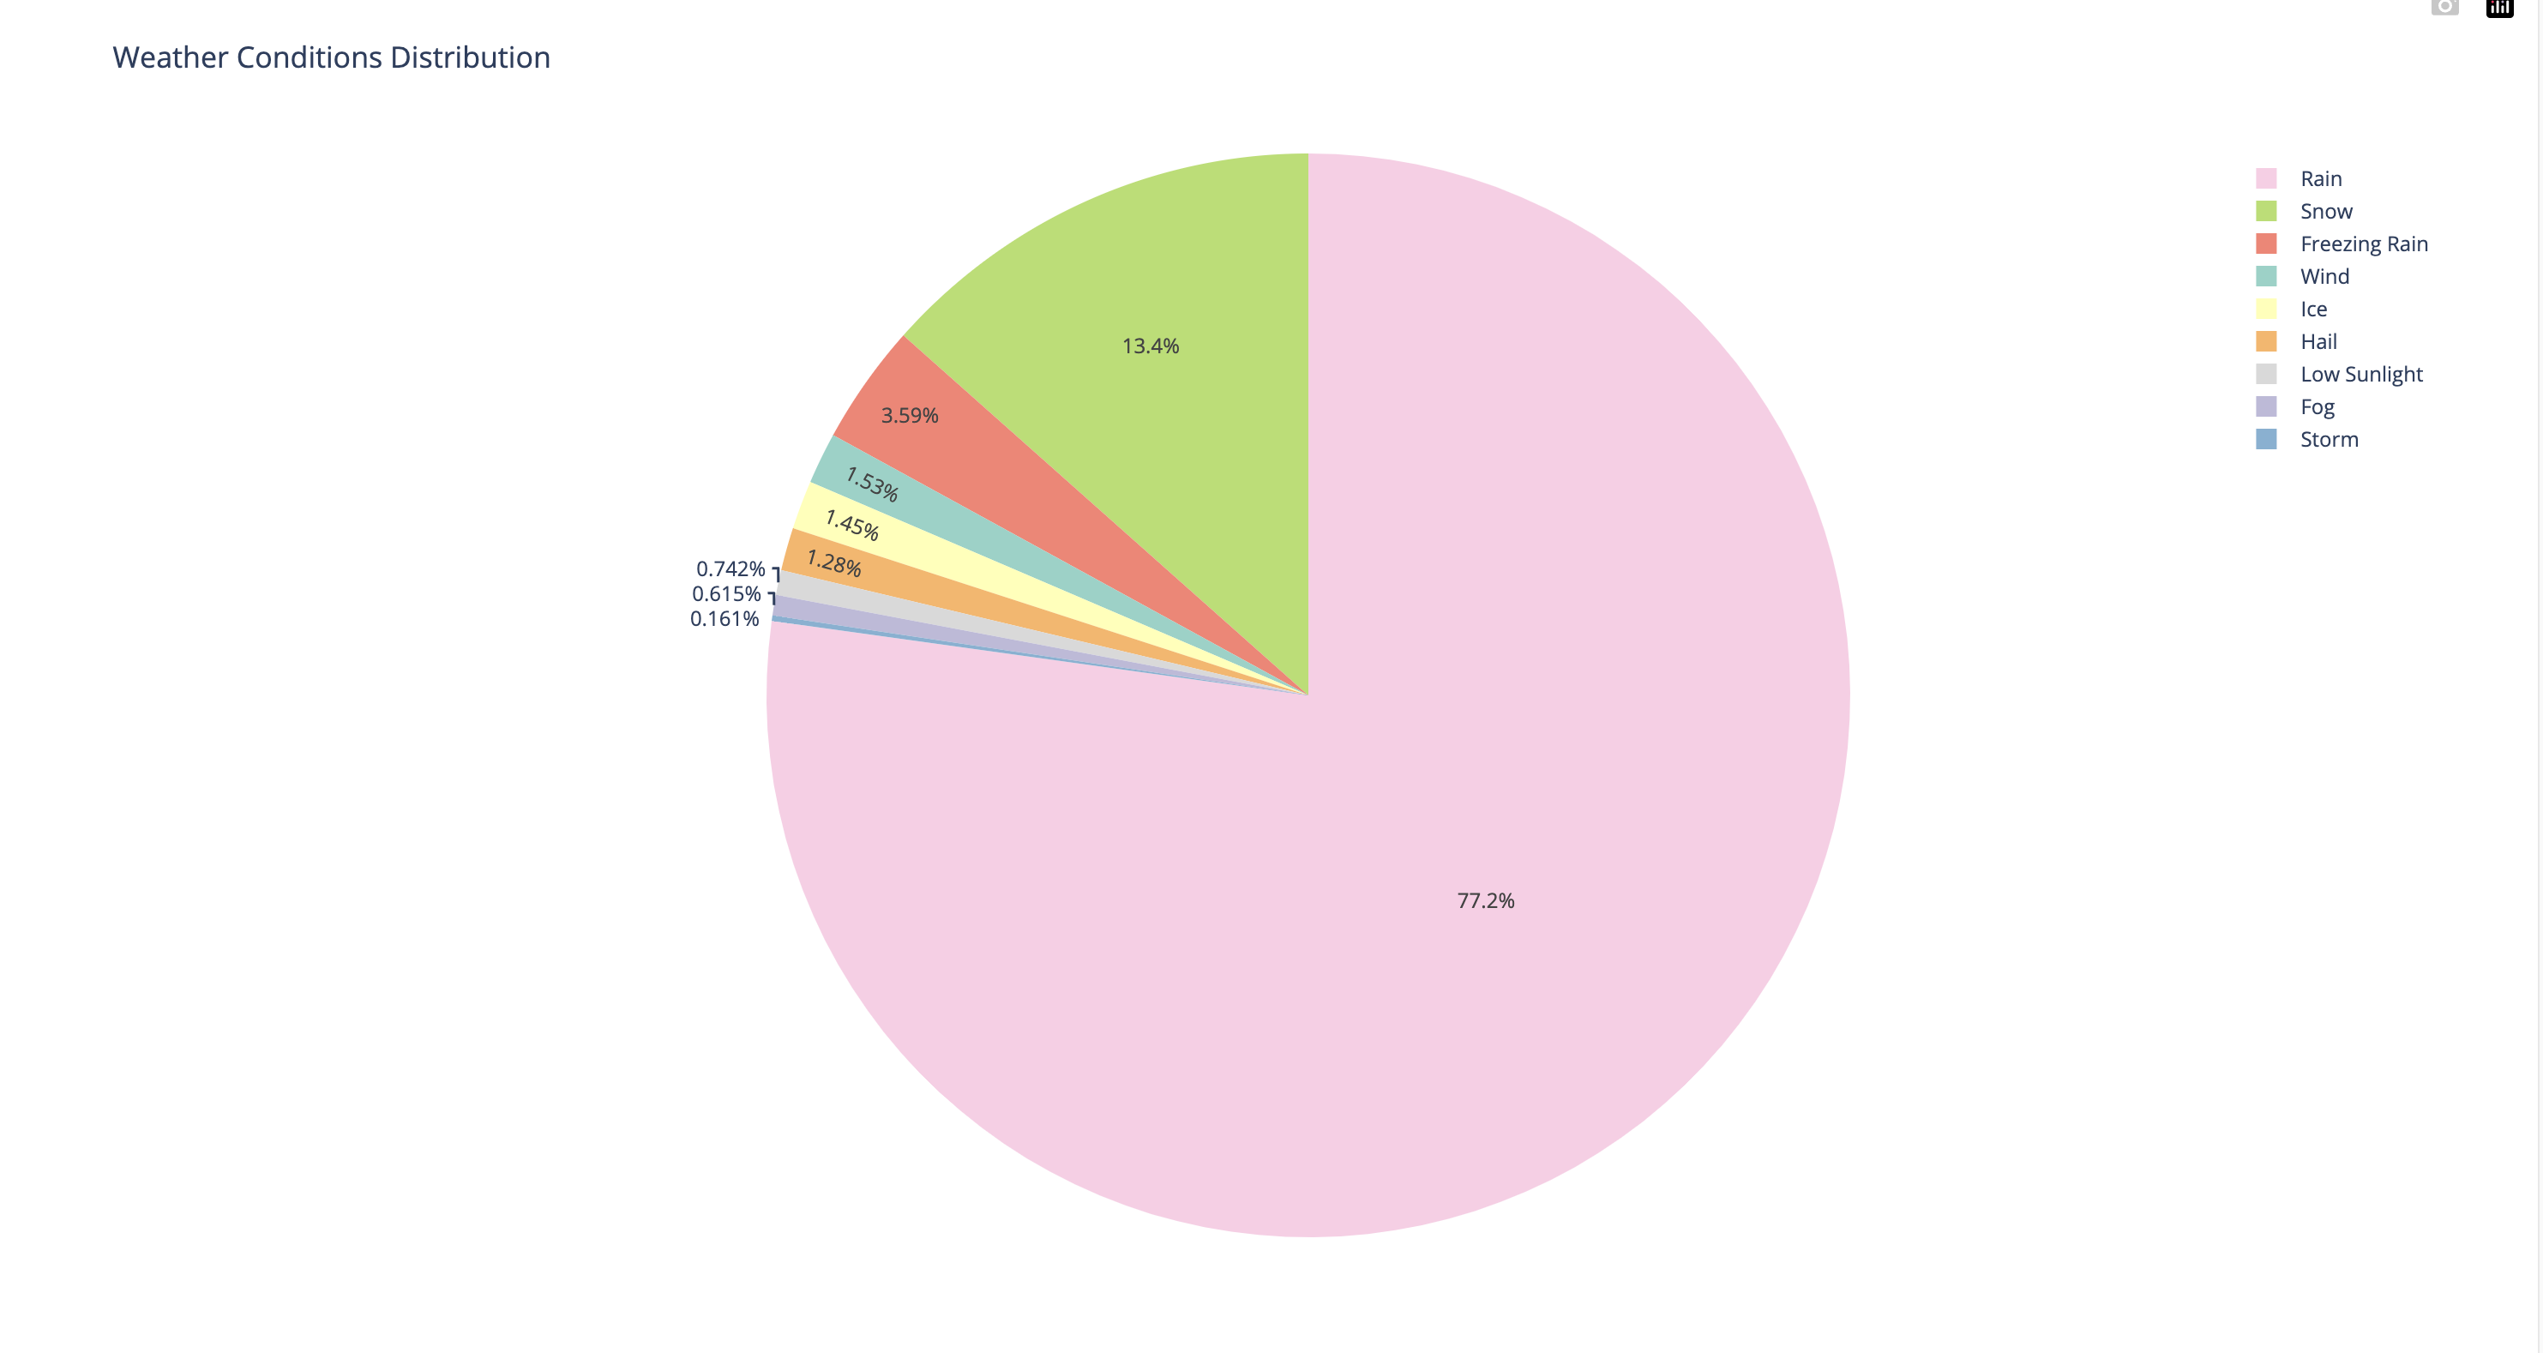
A pie chart for weather distribution provides a clear and concise representation of the proportion of accidents that occurred under different weather conditions.
Each slice of the pie represents a different weather condition category, such as "Clear," "Rainy," "Snowy," etc.
A pie chart for weather distribution is used to provide a quick and visually intuitive summary of the distribution of accidents across different weather conditions.

Slide 12
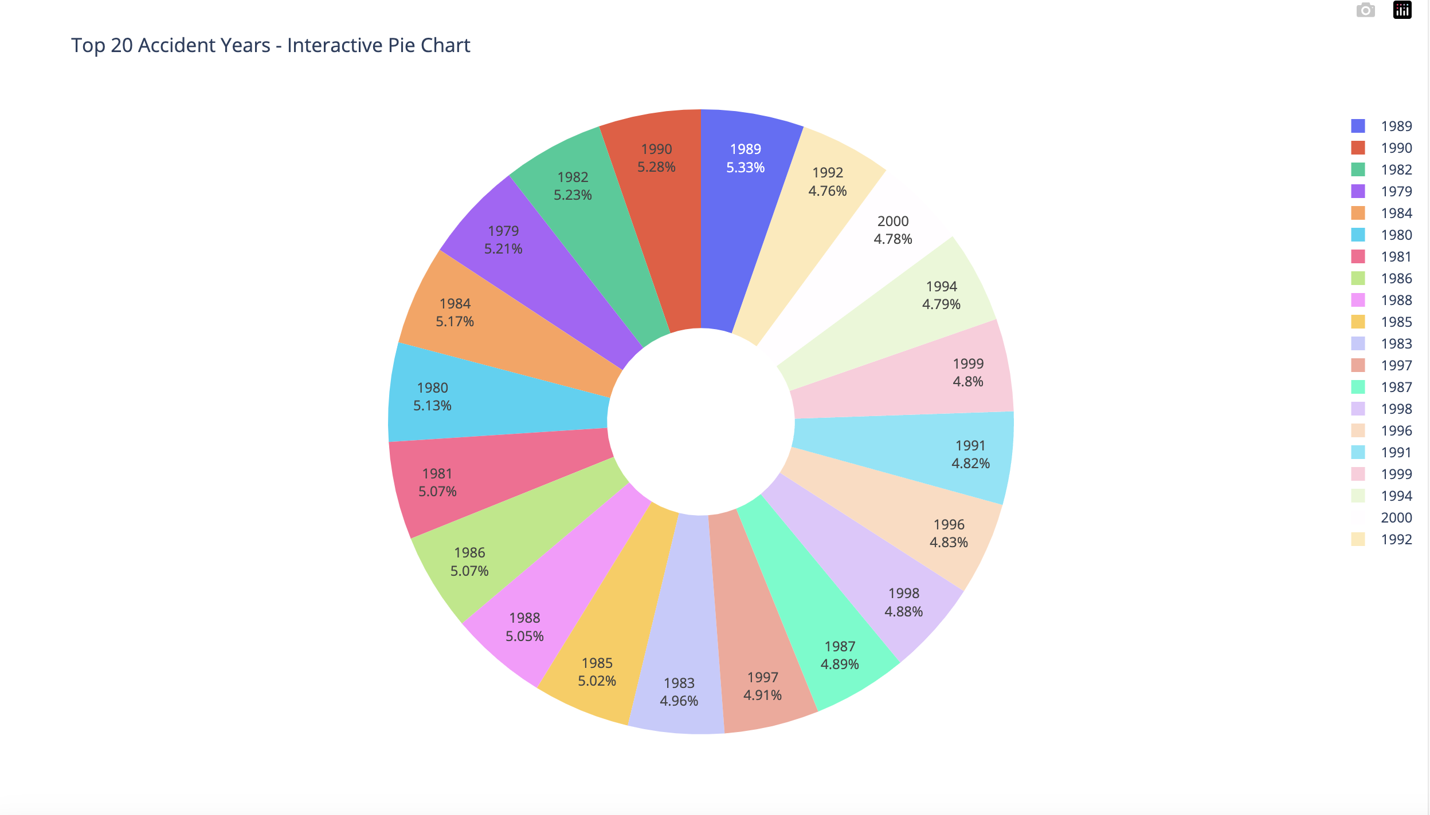
An interactive pie chart for the top 20 accident years can offer an engaging and dynamic way for users to explore and analyze the distribution of accidents over time.
Clicking on a slice expands it for a closer examination of the chosen year's contribution to the overall distribution

Slide 13
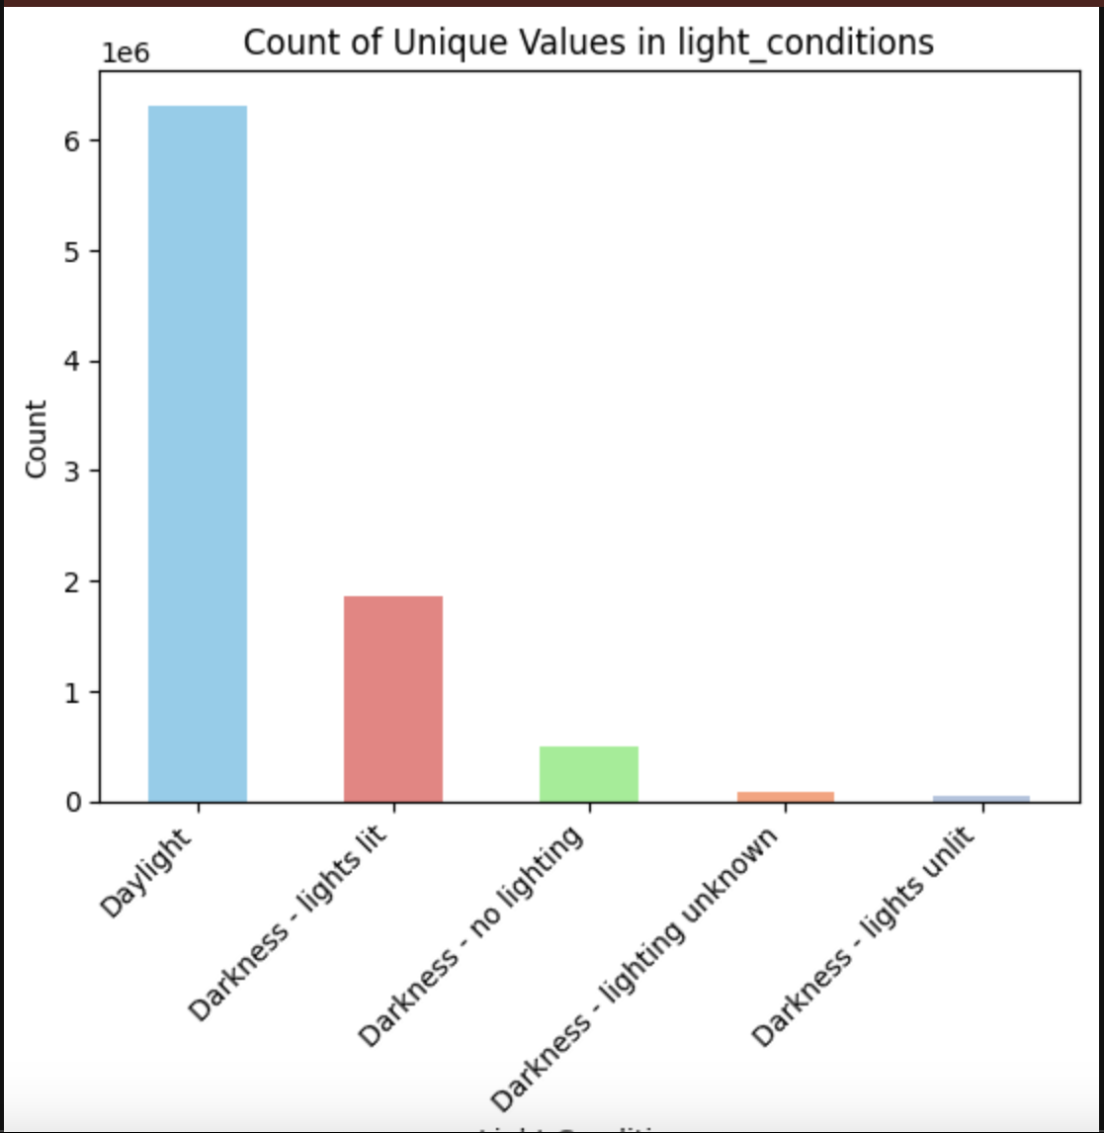
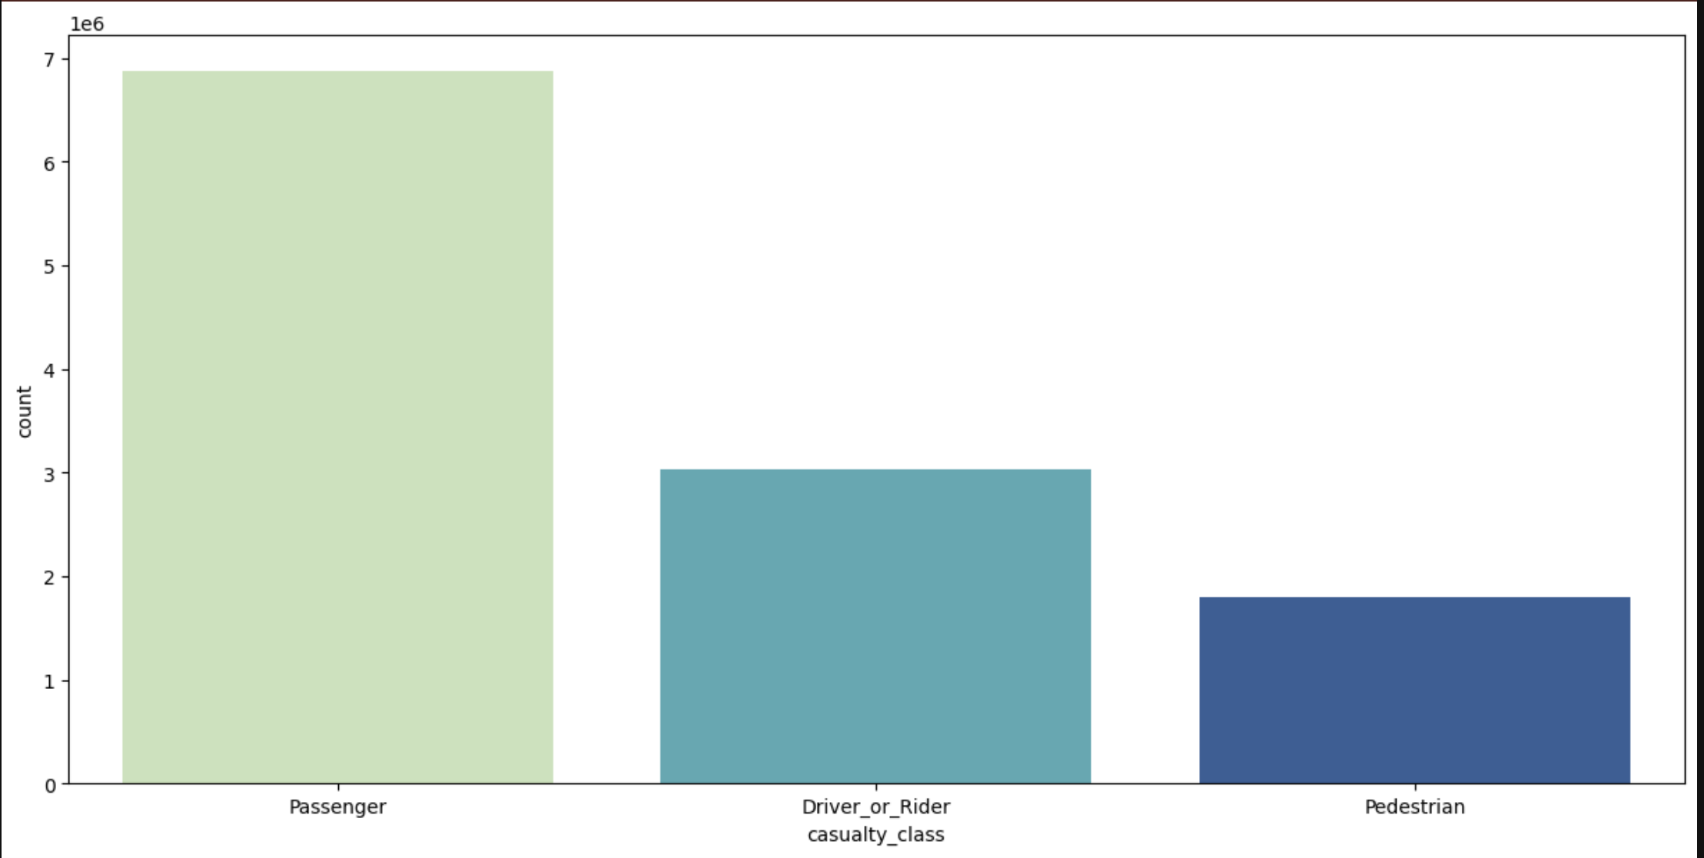

Slide 14
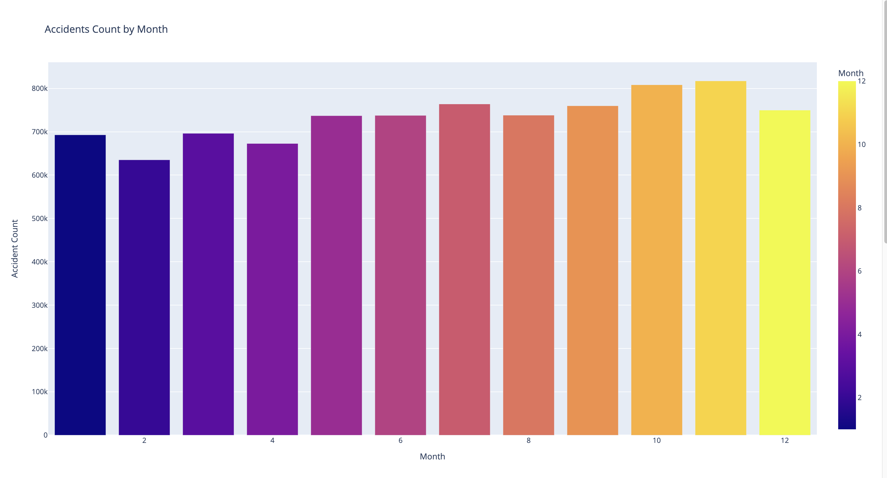
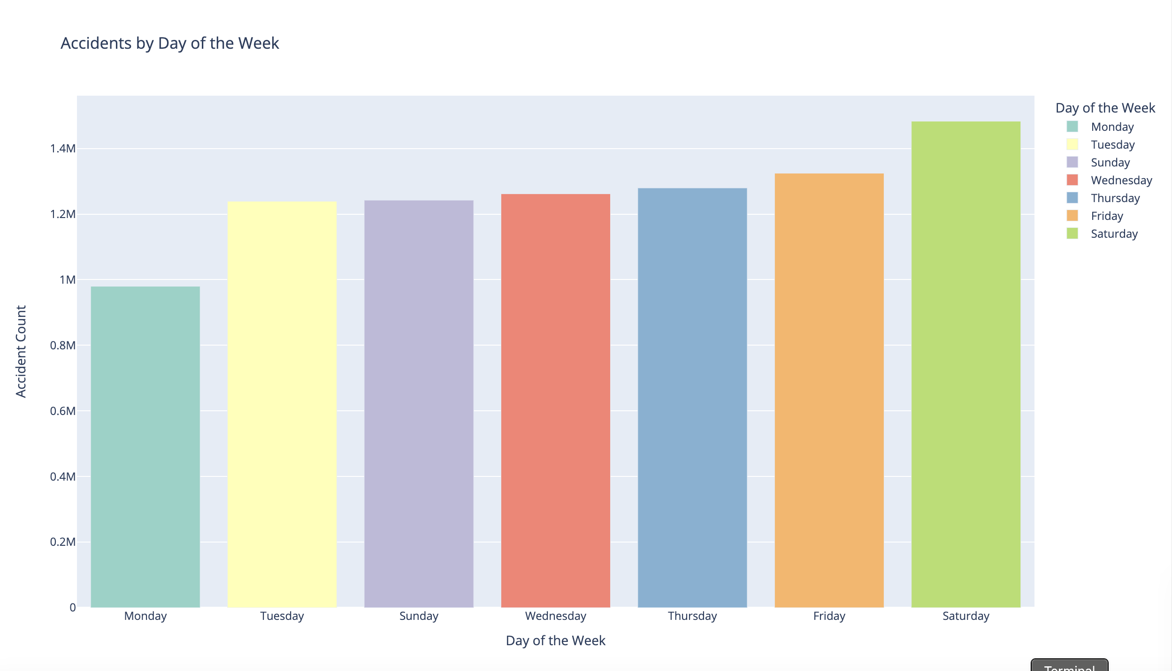

Slide 15

RECOMMENDATIONS
Invest in improved weather monitoring systems and provide real-time alerts to drivers to encourage safer driving during adverse weather conditions.
Implement targeted road safety campaigns and infrastructure improvements in rural areas to reduce the proportion of severe accidents.
Enhance safety measures at high-risk road types, such as installing traffic signals, improving signage, and implementing speed reduction measures.

Slide 16
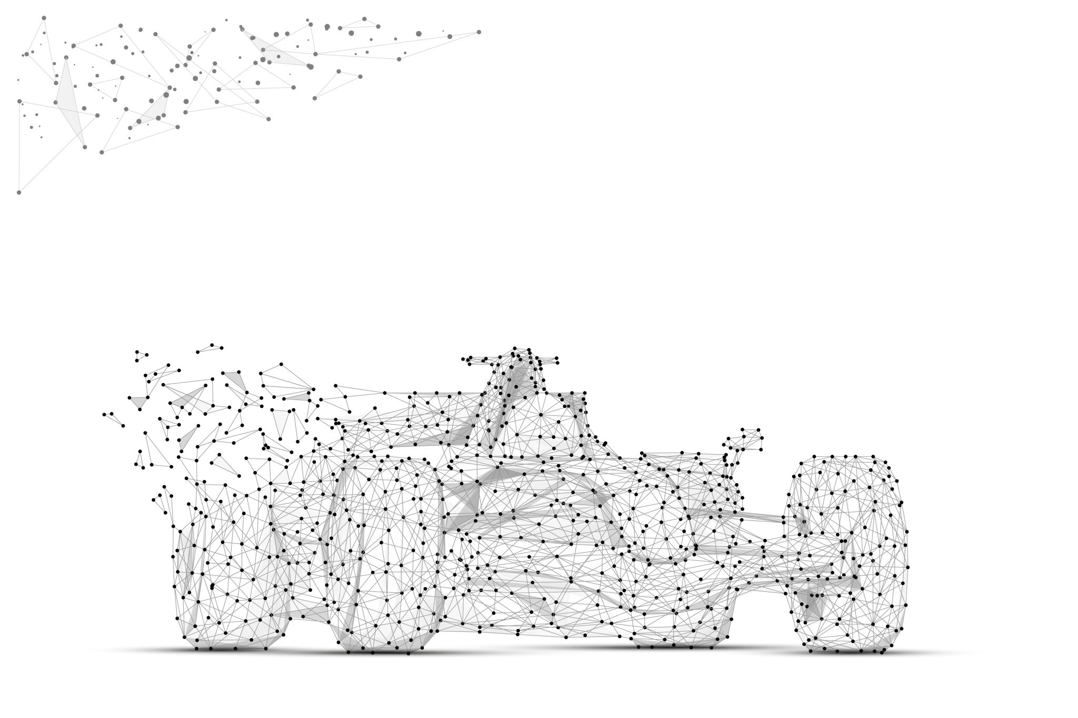
FUTURE OPPORTUNITIES
Advancements in Sensor Technologies:
The integration of more advanced sensors in vehicles and on road infrastructure can provide richer real-time data for accident analysis.
IoT and Vehicle-to-Everything (V2X) Communication:
The growth of IoT and V2X communication can enable seamless information exchange between vehicles, infrastructure, and other connected devices, contributing to a more comprehensive accident severity analysis.
Blockchain for Data Security:
The adoption of blockchain technology can enhance the security and integrity of the data used in accident severity analysis, ensuring trustworthiness and preventing data tampering.

Slide 17

CHALLENGES
1. INCOMPLETE OR INACCURATE DATA
2.DATA INTEGRATION CHALLENGES
3.COMPLEXITY OF VARIABLES

Slide 18

CONCLUSION
The initiative served as a basis for suggestions based on evidence in addition to deepening our understanding of the elements that lead to accidents. These recommendations—which originate from spatial studies and predictive models—may direct focused initiatives and policy modifications, which would ultimately improve road safety and lessen the severity of accidents.
The knowledge gathered from this initiative will be a useful tool in the future for developing strategies related to road safety. Developing more robust and safe transportation systems will require utilizing technological breakthroughs and adopting a comprehensive view of road dynamics. In the area of traffic safety, this project represents a major step toward promoting a culture of safety, informed decision-making, and ongoing development.

Slide 19

REFERENCES
Eboli, L., Forciniti, C., & Mazzulla, G. (2020). Factors influencing accident severity: an analysis by road accident type. Transportation Research Procedia, 47, 449–456. https://doi.org/10.1016/j.trpro.2020.03.120
Chand, A., Jayesh, S., & Bhasi, A. (2021). Road traffic accidents: An overview of data sources, analysis techniques and contributing factors. Materials Today: Proceedings, 47, 5135–5141. https://doi.org/10.1016/j.matpr.2021.05.415

Slide 20

THANK YOU

